Slide 1
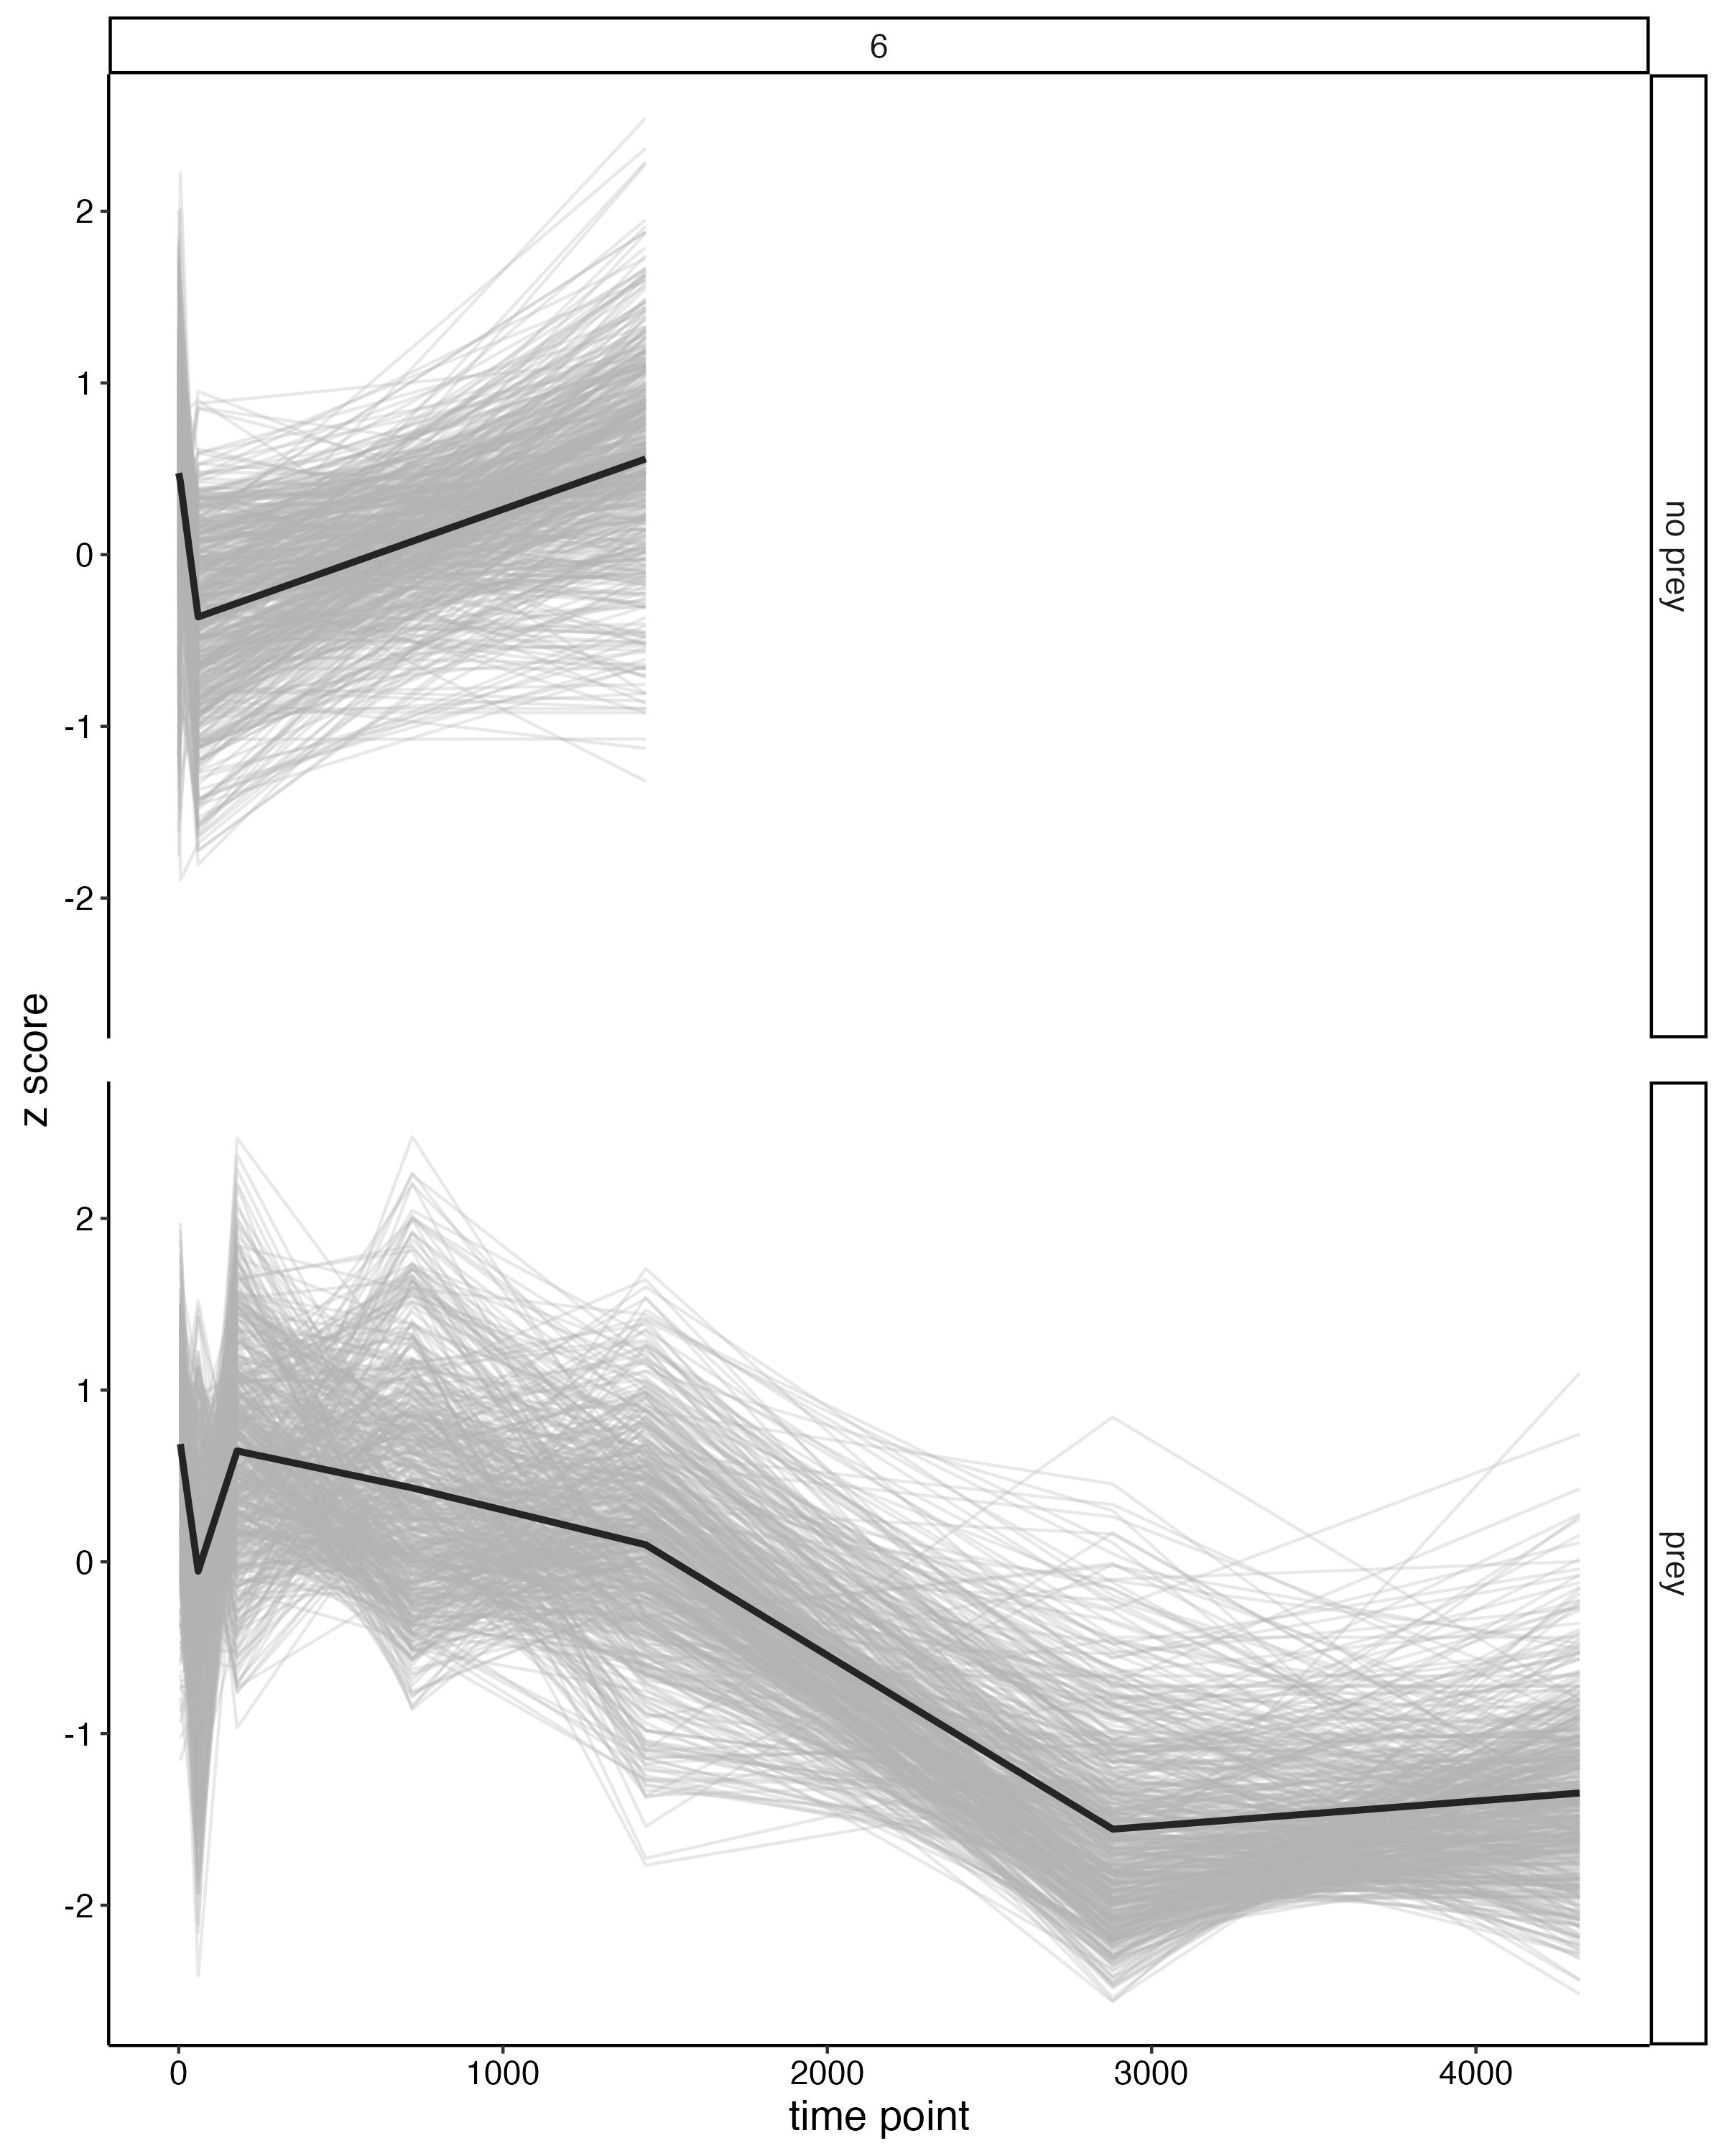
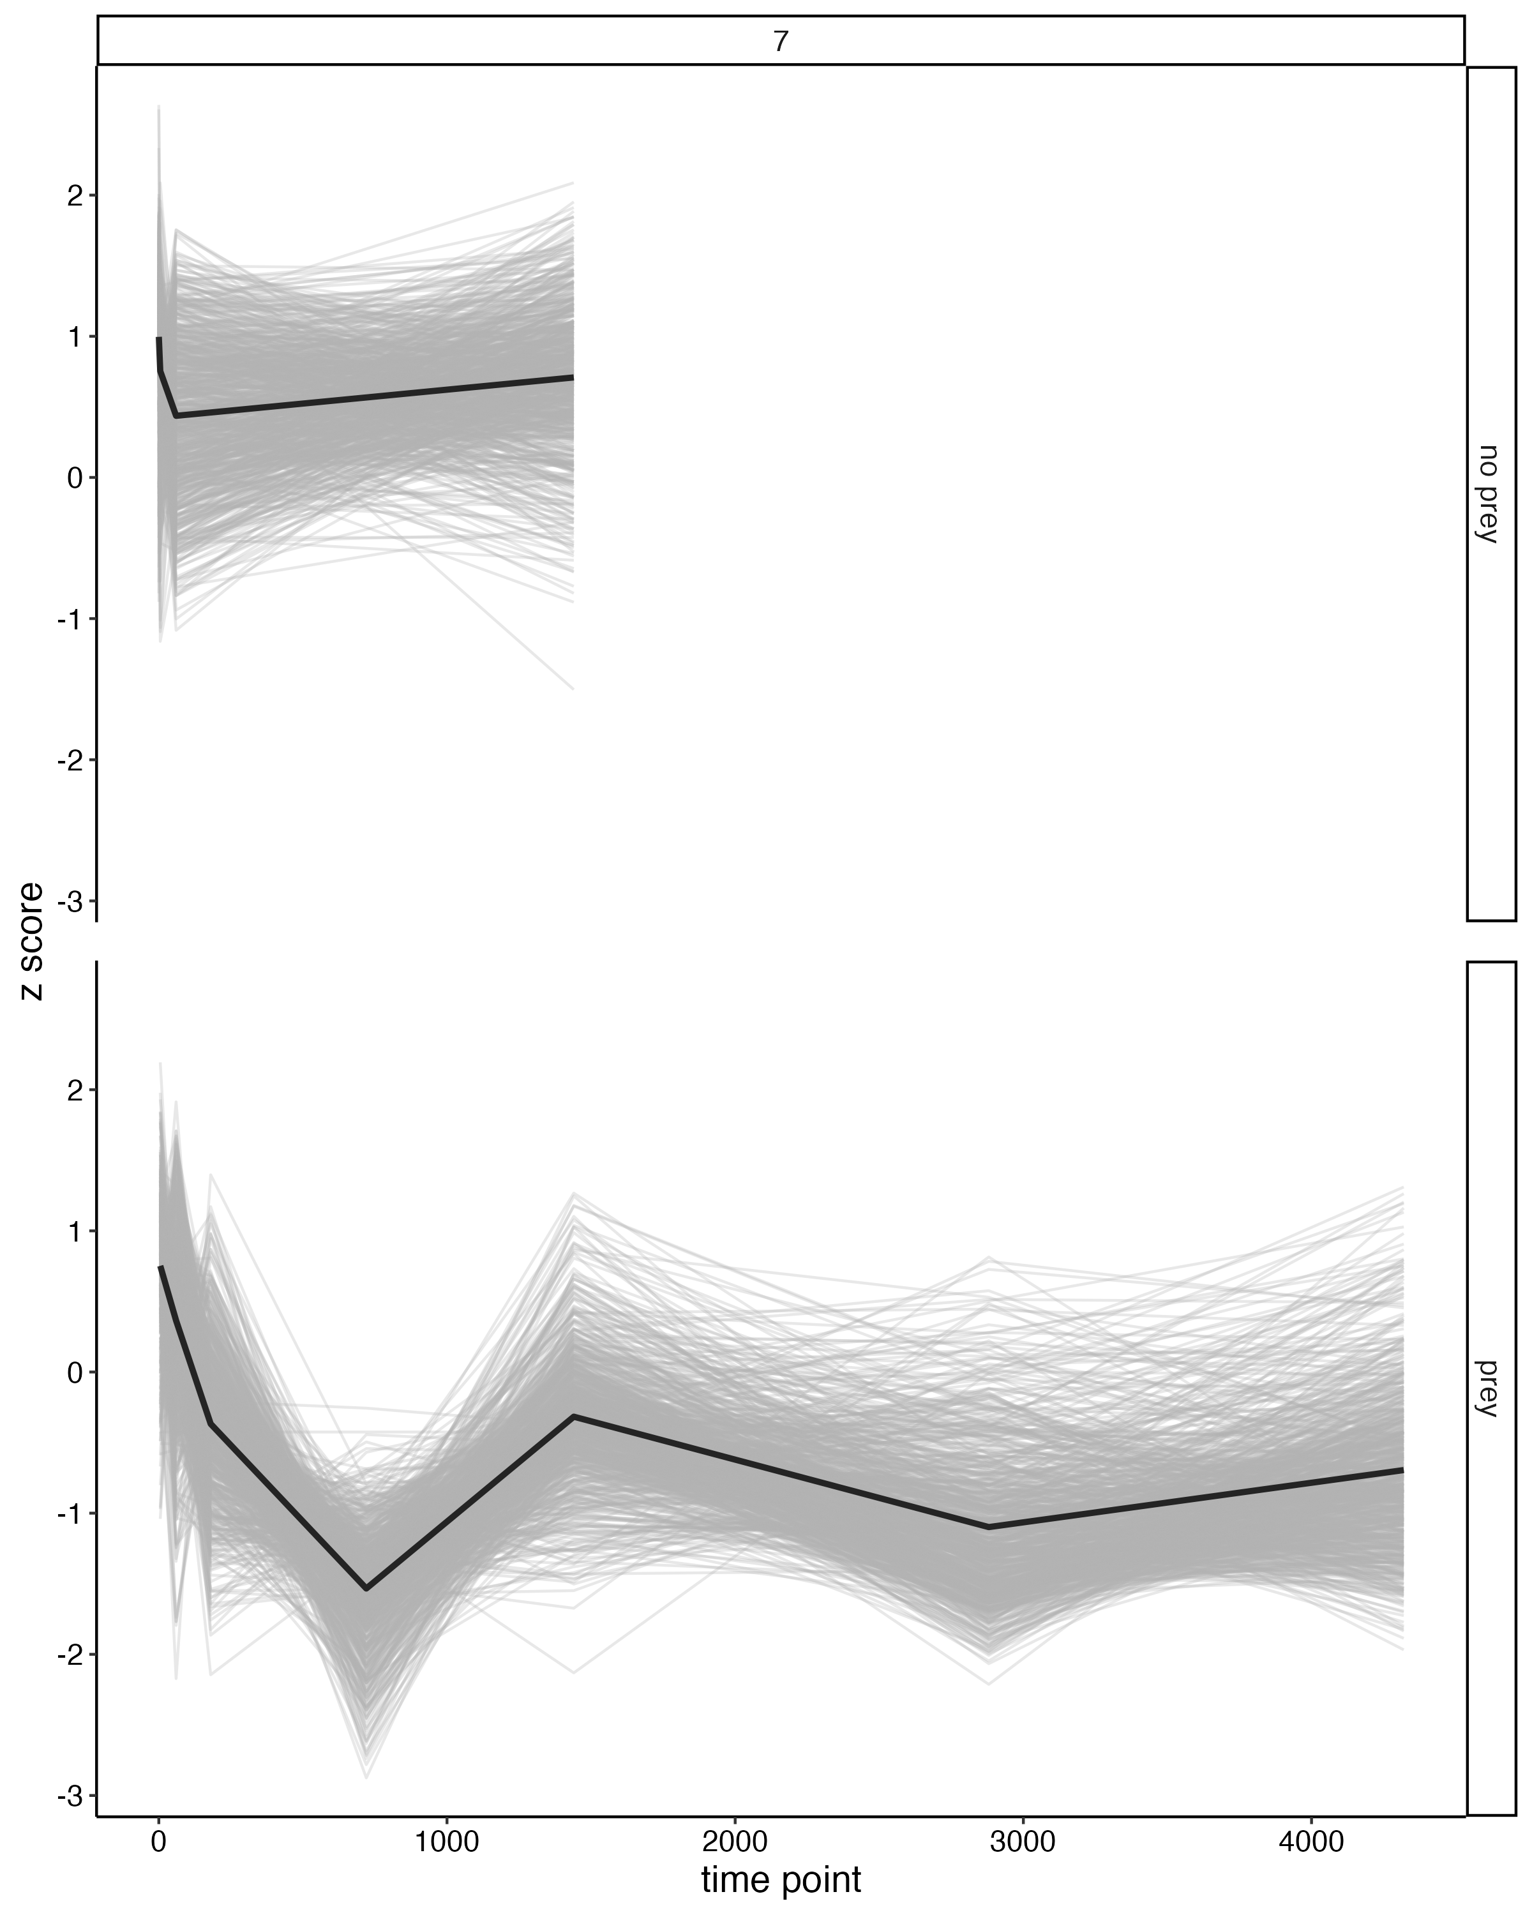
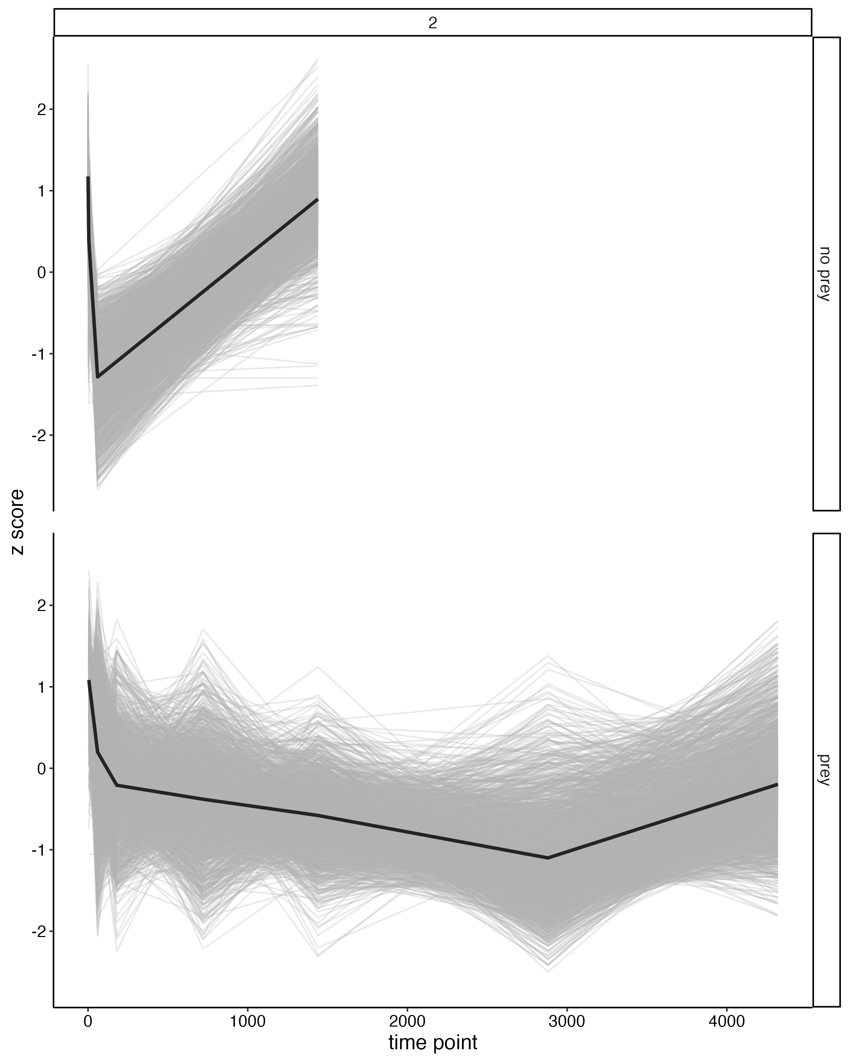
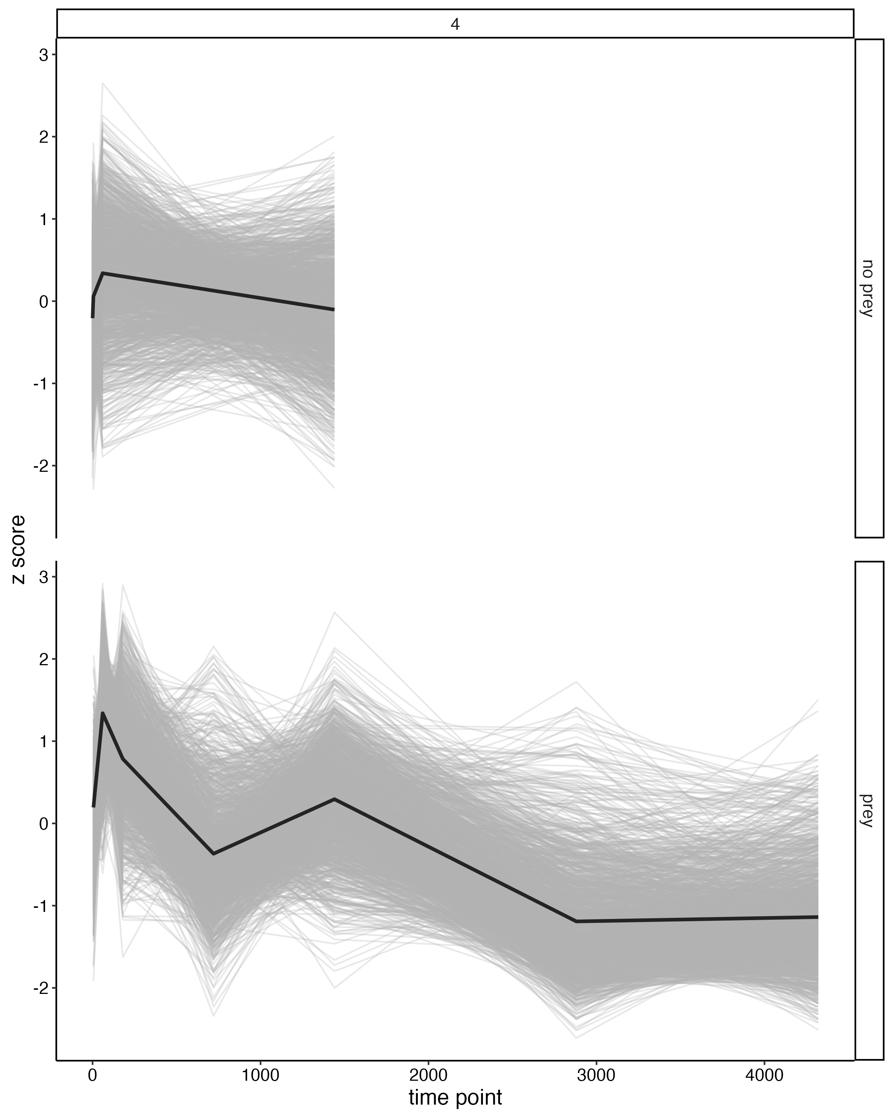
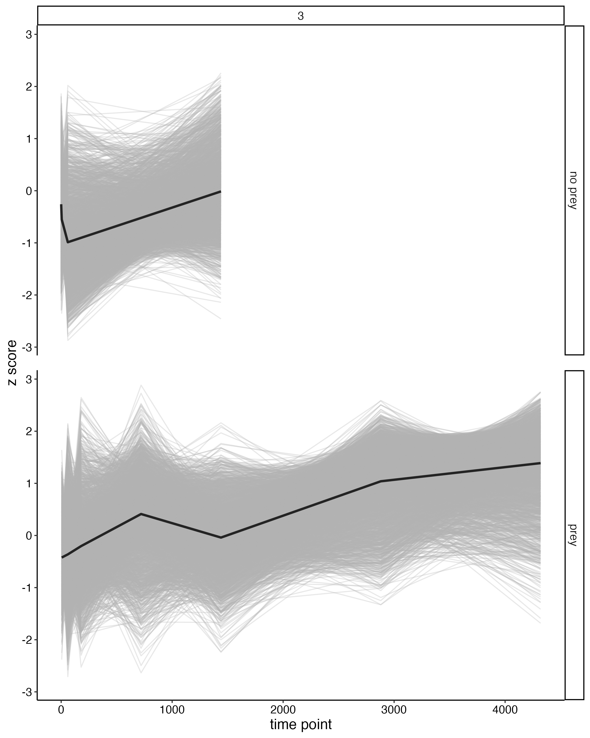
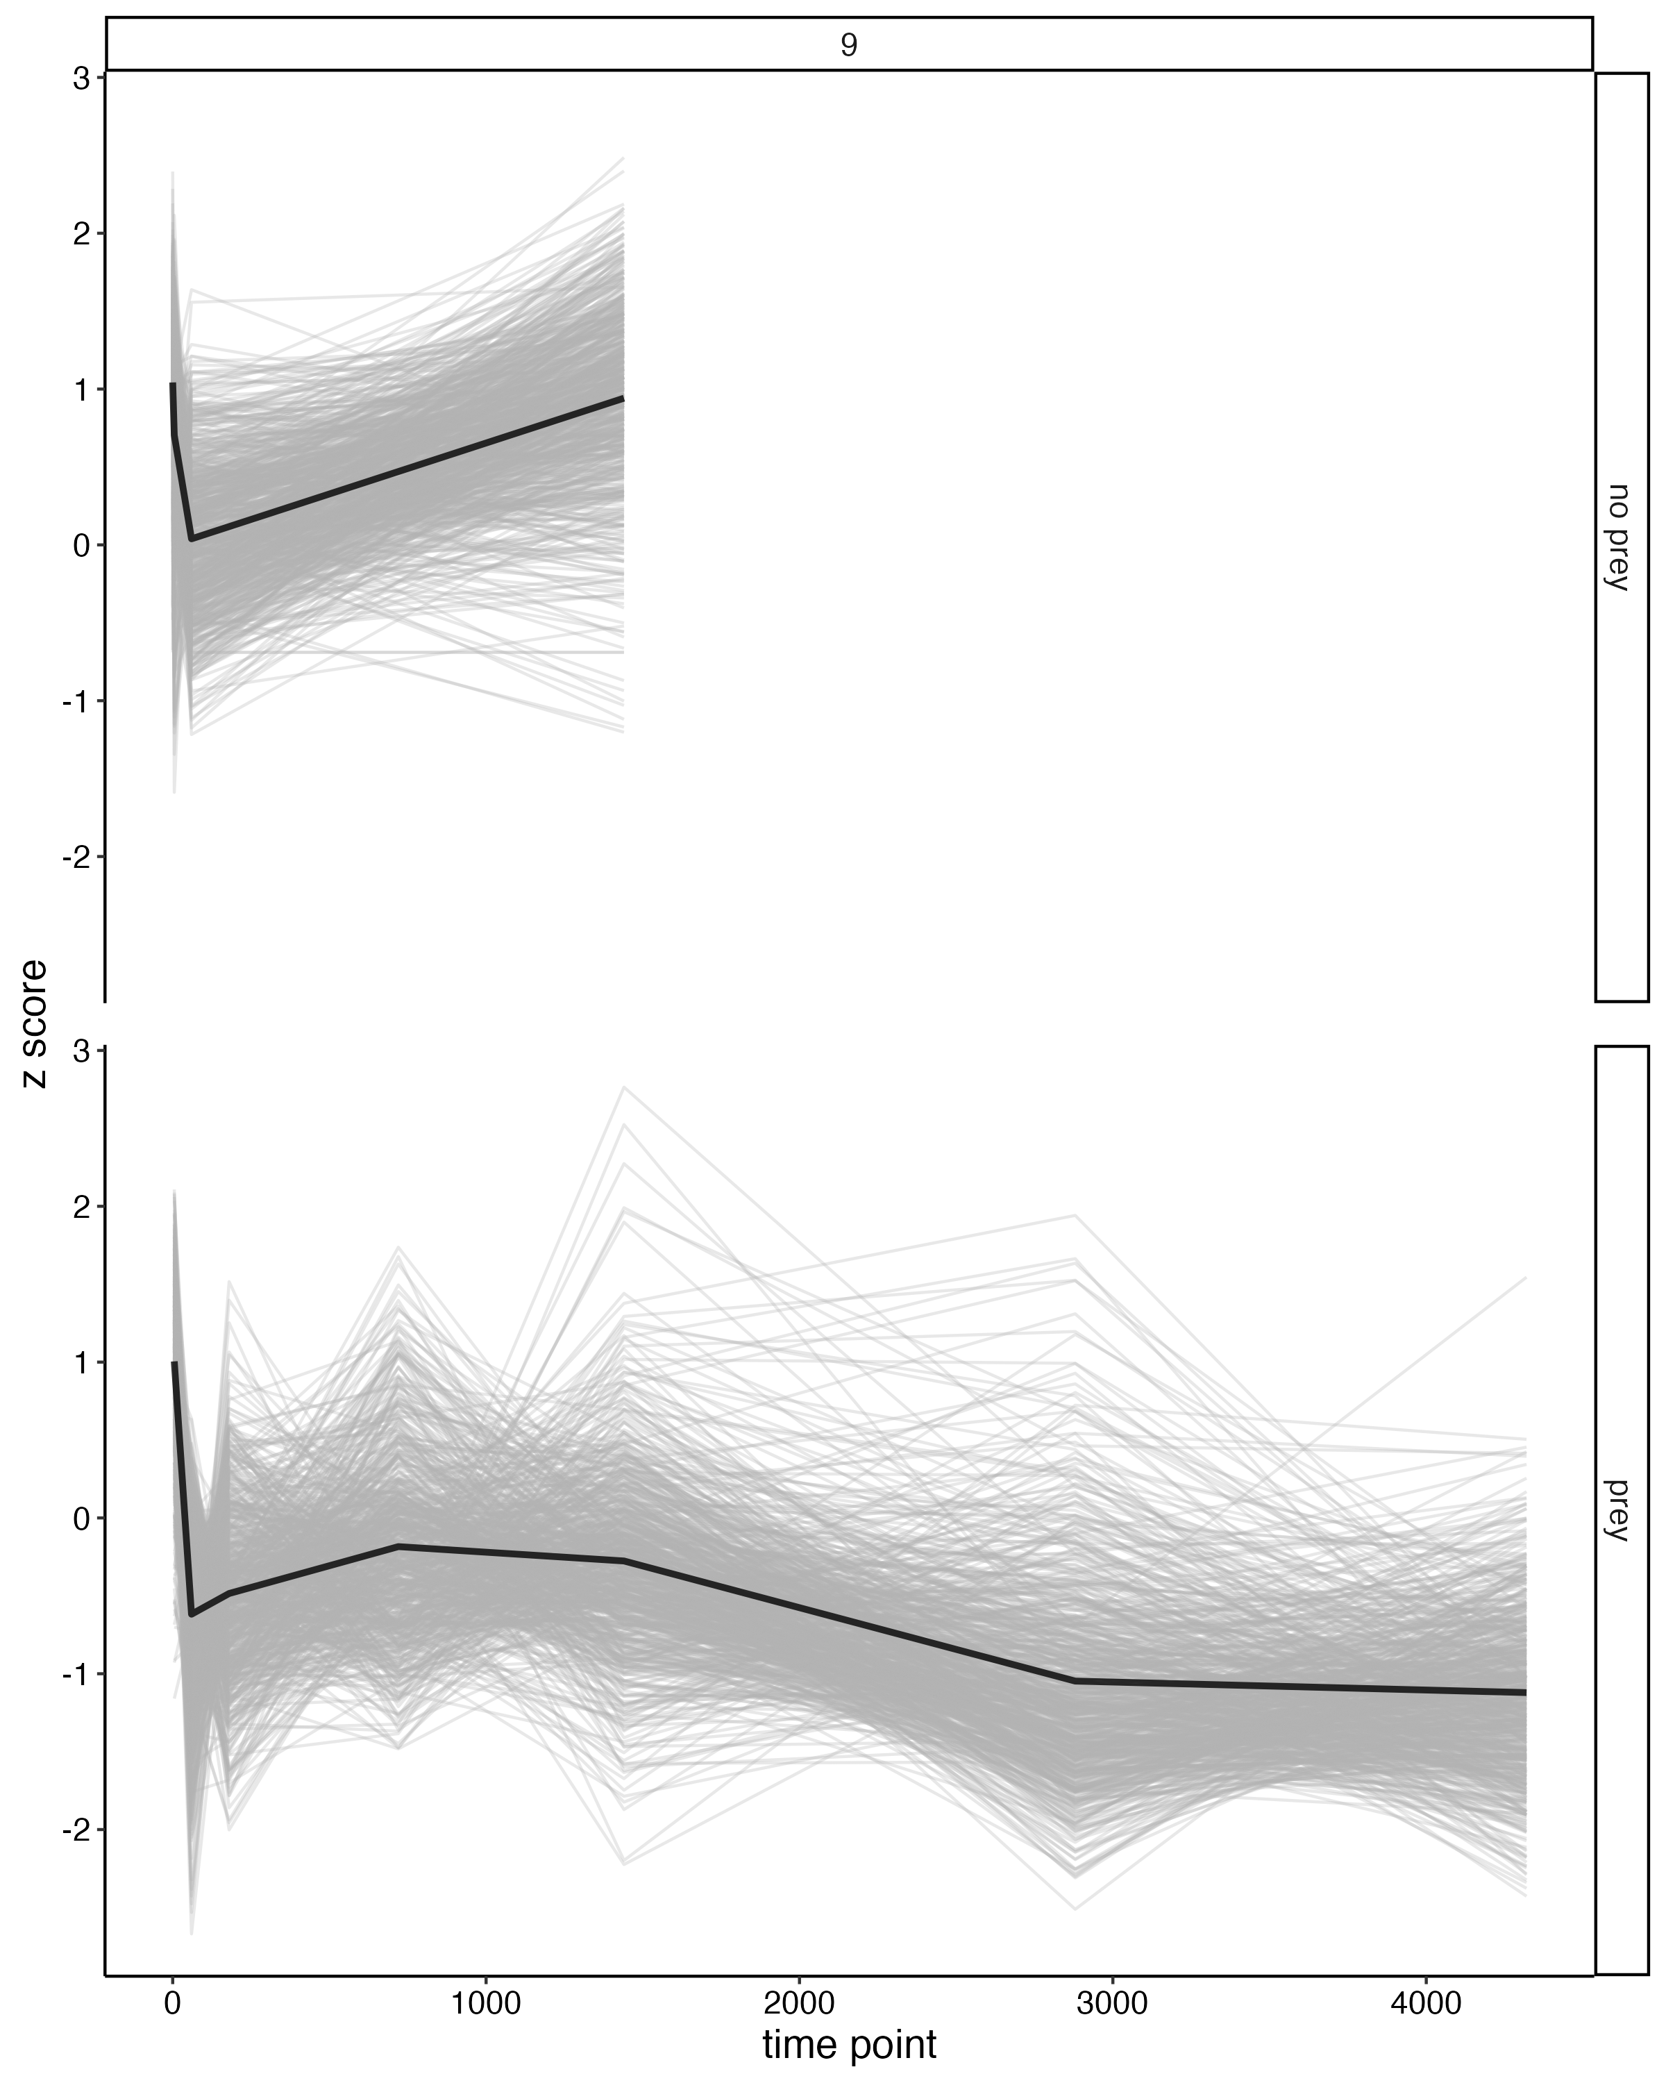
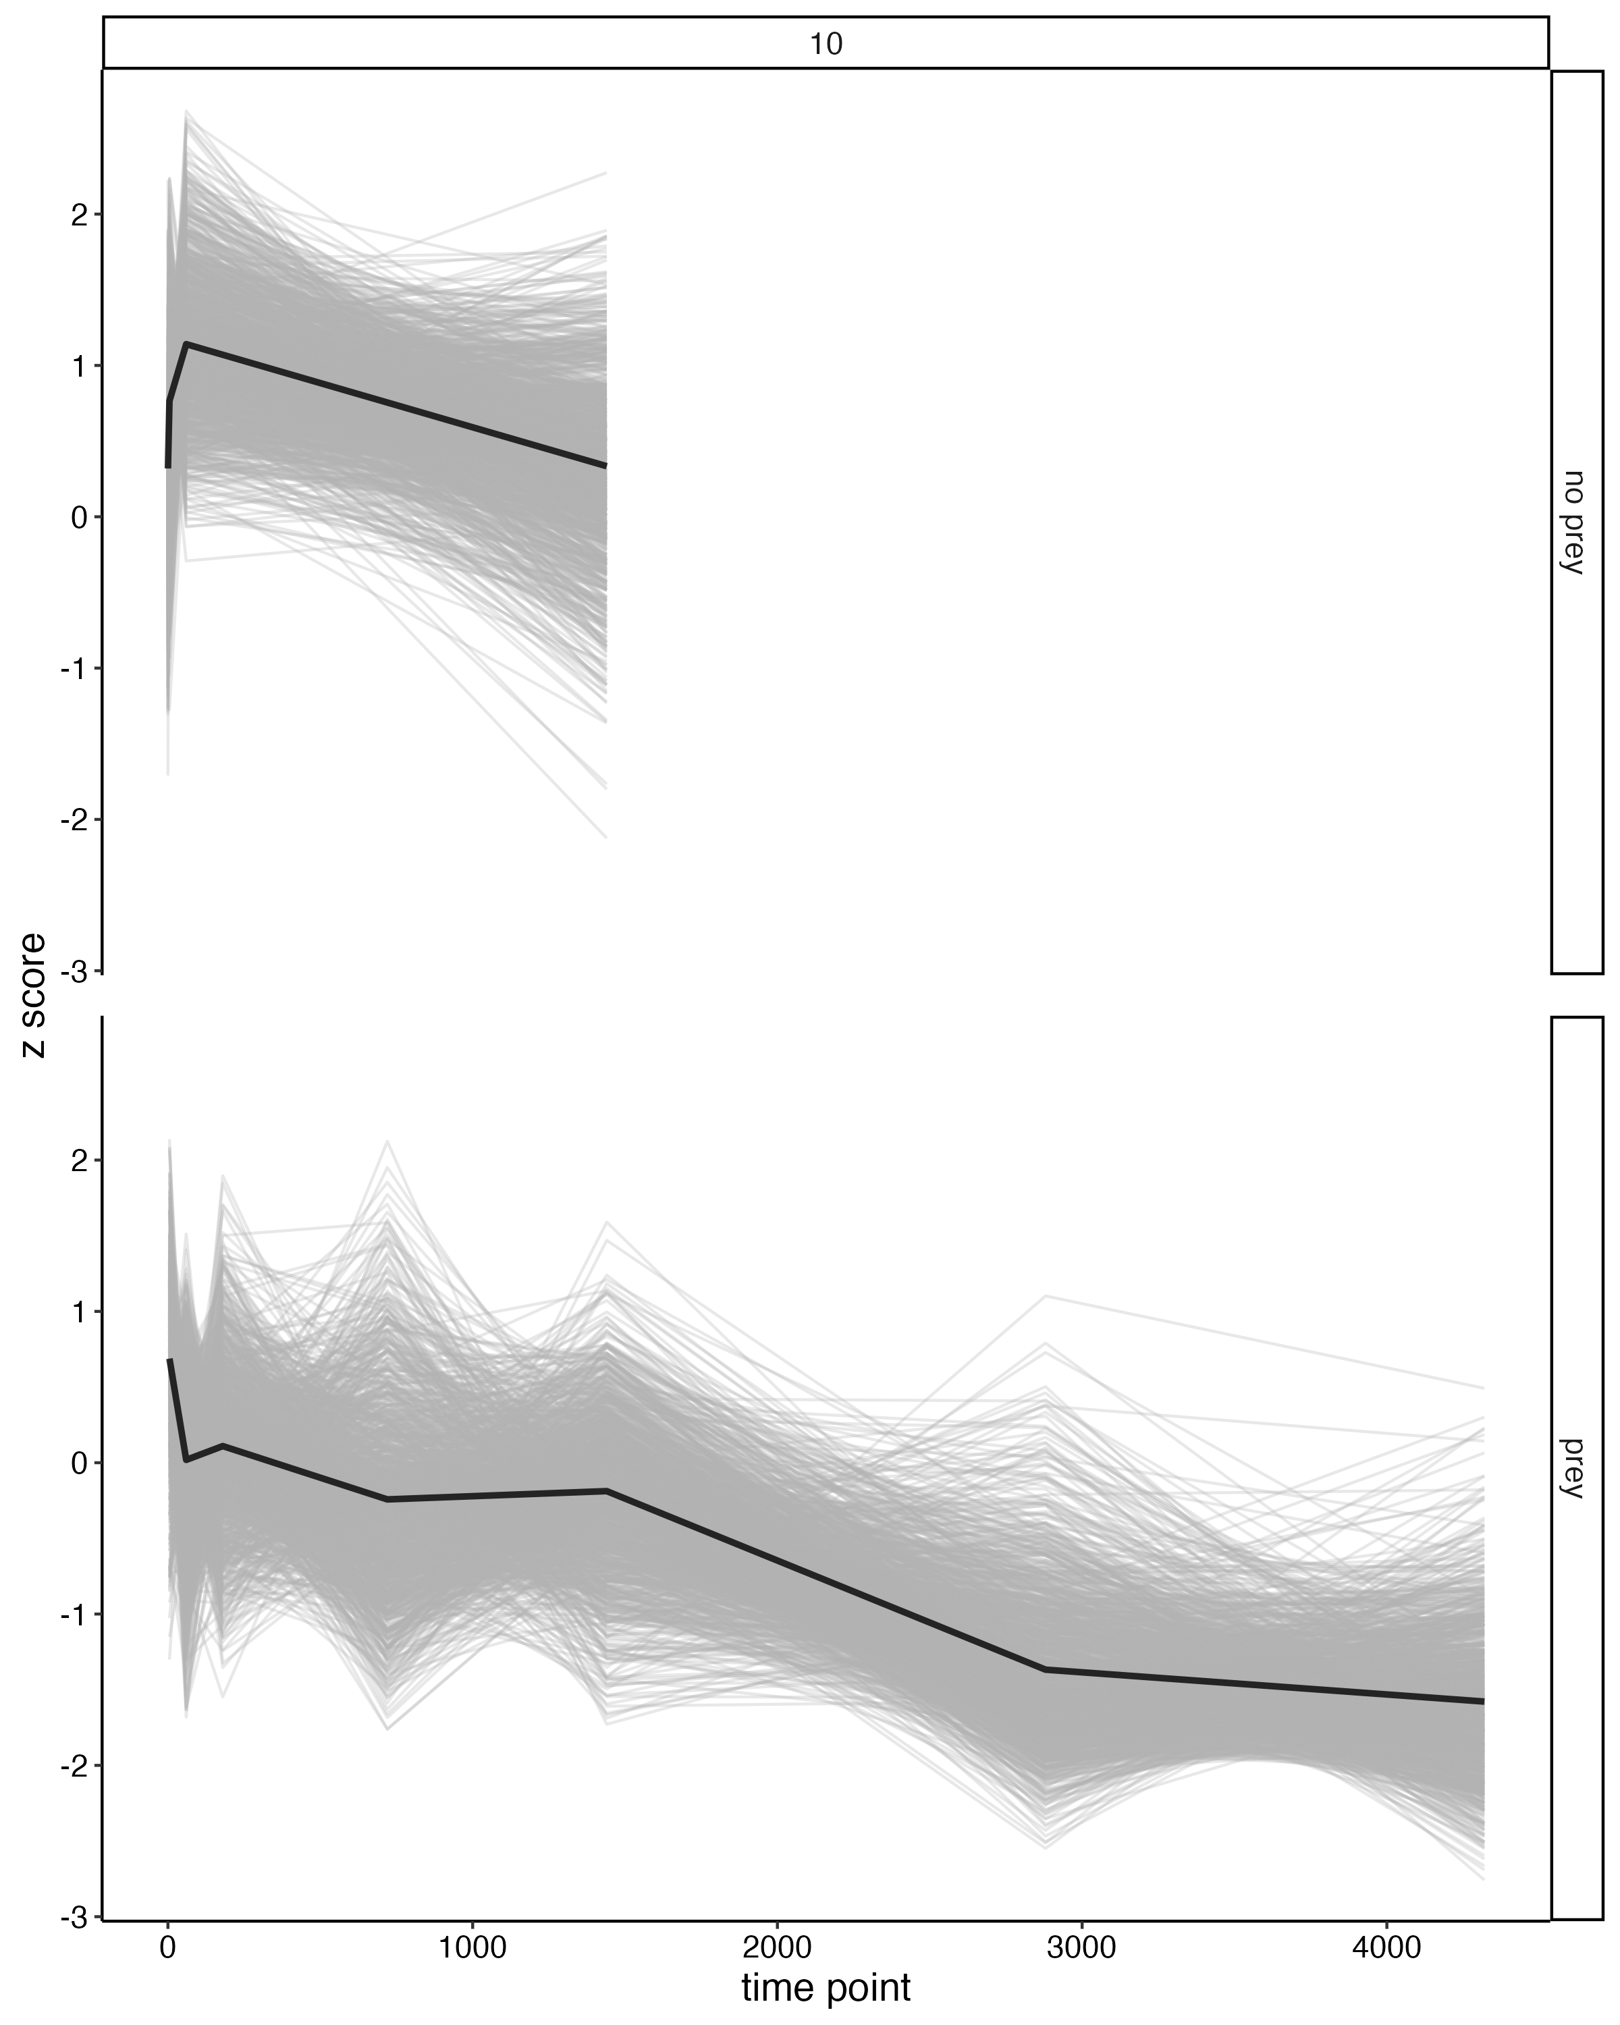
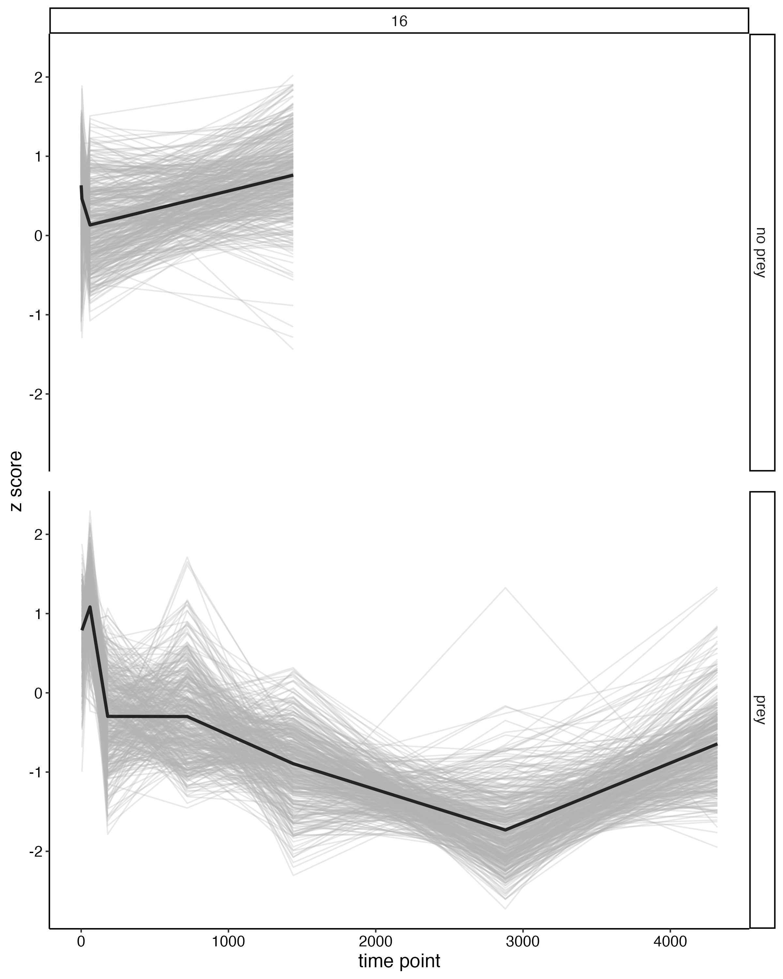
Prey Vs. No Prey 1 hr time point
174 DEG’s 8 modules: 2,3,4,6,7,9,10,16
Enzymes:
1 lipase,
3 phosphatases
71 upregulated in no prey –
module 3,6,7,9,10
Enzymes:
1 peptidase
103 upregulated in prey module 2,3,4,16

Slide 2
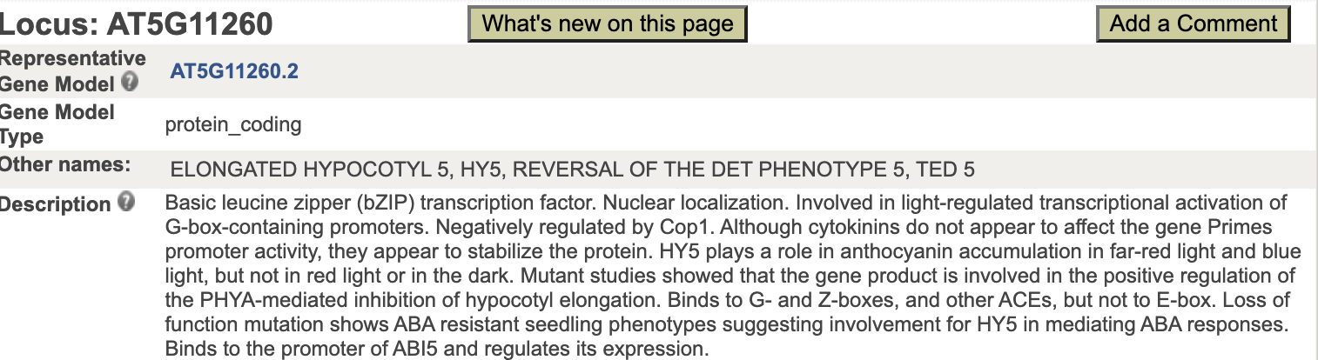
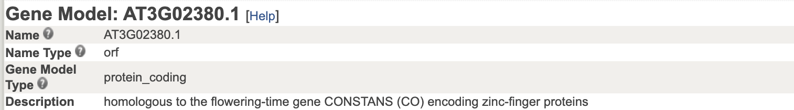
Prey Vs. No Prey 24 hr time point
151 DEG’s 5 modules: 2,3,4,6,10
2 upregulated in no prey –
module 2 and 6

Slide 3
Prey Vs. No Prey 24 hr time point
151 DEG’s 5 modules: 2,3,4,6,10
2 upregulated in no prey –
module 2 and 6
149 upregulated in prey –
module 3,4,10
Enzymes: 1 chitinase, 1 lipase, 1 peroxidase,
1 protease, 4 phosphatases, 3 peptidases

